Slide 1

ELECTRONICS
GADGETS
By PATEL DHARATI(195160793020) SHAH DARSHINI(195160793029)

Slide 2
1.1 Existing System
Limited Electronics Options available
Many Customers go for purchasing offline so as to examine the product and hold the possession of the product just after the payment for the product.
In this contemporary world customer’s loyalty depends upon the consistent ability to deliver quality, value and satisfaction. Offline Electronic has a sense of immediacy.
If we can search and make a list of items that we would like to try while shopping, before actually going out.
Lack of Communication
Size problem
Time Consuming

Slide 3

1.2 Need of New System
To make customer aware of latest Products for different Occasions.
Customer can select more than one product into a Cart At a time and can check out.
Customer can make payment by COD(Cash On Delivery) Or Online cash payment (Paypal)
Facilities.

Slide 4
1.3 Objective of New System
This project is aimed at developing a web application that depicts Electronic Gadgets.
This application helps customer to find different type of Electronic Gadgets of different material (body), look and style at a single place.
In this application customer can have wide range or categories of Electronic products in the reliable price.

Slide 5

1.4 Advantages of proposed system
Speed
Time - Saving
Automatic Reports Production
Accuracy
Availability of Information
Efficiency
Legibility
Cost Saving
Environment Friendly

Slide 6

1.5 Limitations of proposed system
User’s must be trained with basic web application functionality.
User’s must have the basic knowledge of English.
The System must be able to respond to database software within reasonable time.
It requires an internet connection.
It requires large database.
Access needed

Slide 7
2.1 Requi. Determination and Analysis
CORE COMPONENTS:
Front End | Laravel 5.7
Back End | My SQL 5.7
HARDWARE REQUIREMENTS:
Processor | Core i3 or higher
RAM | 256MB or higher
Hard Disk | 90 GB or higher
SOFTWARE REQUIREMENTS:
OS | Windows
Server | Apache 7.0
Database | MySQL 5.7

Slide 8



2.2 Targeted User
Are you a?
1. Admin
2. Customer
3. Visitor

Slide 9
Admin User
Admin
Login
Edit Profile
Generate Reports
Manage Product
Manage Category
Manage Order
Logout
Customer
Visitor

Slide 10
Customer User
Registration
Login
View Product
Edit Profile
View Category
Payment
Logout
Admin
Customer
Visitor

Slide 11

Visitor User
Admin
View Product
View Category
Logout
Customer
Visitor

Slide 12
2.3 Modules
CATEGORY
01
02
03
ORDER
PRODUCT
04
PAYMENT

Slide 13
Category
Category contains the main type of product.
For example,
Mobile
Laptop
T.V.
In this , the admin can add ,update and delete the category.
The user can search the category and view the category.
The visitor can search the category and view the category

Slide 14
2.2 Product
Product contains the product name that the user can purchase.
For example,
Tv,
laptop,
mobile Etc.
Admin can add, update and delete the product.
User can search, view and purchase the product.
Visitor can search and view the product.
User and visitor can’t add ,update, delete the product.

Slide 15
Order
When user want to purchase or place order of the product then he/she must be logged in.
After the registration, user can login and select the product which user want to add to cart.
After the product is adding to add to cart, we show them the view in which there are three options:-
Delete order
Place order
Continue Shopping

Slide 16
Payment
In the payment there are two types option.
Cash on delivery
Online payment
After the verifying the form, user choose option for confirm order

Slide 17
3. System Design
DATA DICTIONERY
Cart
Coupon
Delivery Address
Order
Product_Attr
Gallery
User
Category
Product

Slide 18
3. System Design
Category
Sr.No | Field Name | Data Type | Size | Constraint | Description
1 | User_id | Int | 6 | Primary Key | This field defines unique id of Use
2 | name | Varchar | 30 | Not Null | This field defines Name of User
3 | Email | Varchar | 30 | Not Null | This field defines Email of User
4 | Mobile | Varchar | 13 | Not Null | This field defines Mobile of User

Slide 19
3. System Design
Category
Sr.No | Field Name | Data Type | Size | Constraint | Description
1 | Category_id | Int | 6 | Primary Key | This field defines unique id of Category
2 | name | Varchar | 30 | Not Null | This field defines Name of Category
3 | Status | Varchar | 1 | Not Null | This field defines Status of Category

Slide 20
3. System Design
Product
Sr.No | Field Name | Data Type | Size | Constraint | Description
1 | id | Int | 6 | Primary Key | This field defines unique id of Use
2 | Category_id | Int | 6 | Foreign Key | This field is reference from Category table
3 | name | Varchar | 30 | Not Null | This field defines Name of Product
4 | Color | Varchar | 25 | Not Null | This field defines Color of Product
5 | Description | Varchar | 30 | Not Null | This field defines description of Product
6 | Price | Int | 5 | Not Null | This field defines Price Product
7 | Image | Varchar | 30 | Not Null | This field defines img of product

Slide 21
3. System Design
Cart
Sr.No | Field Name | Data Type | Size | Constraint | Description
1 | Product_id | Int | 6 | Primary Key | This field defines unique id of Product
2 | Product_name | Varchar | 11 | Not Null | This field defines Name of Product
3 | Product_code | Int | 8 | Not Null | This field defines Code of Product
4 | Product_code | Varchar | 20 | Not Null | This field defines Color of Product
5 | Size | Varchar | 11 | Not Null | This field defines Size of Product

Slide 22
3. System Design
Cart
Sr.No | Field Name | Data Type | Size | Constraint | Description
6 | Price | Int | 8 | Not Null | This field defines Price of Product
7 | Quantity | Int | 10 | Not Null | This field defines Qty of Product
8 | User_email | Varchar | 200 | Not Null | This field defines Useremail of Product

Slide 23
3. System Design
Coupon
Sr.No | Field Name | Data Type | Size | Constraint | Description
1 | Coupon_id | Int | 6 | Primary Key | This field defines unique id of Coupon
2 | Amount_type | Varchar | 100 | Not Null | This field defines Type of Coupon
3 | status | Boolean | 1 | Not Null | Not Null This field defines Status of Category
4 | Amount | Int | 3 | Not Null | The fields define Amt of Category
5 | Expiry_date | Date | - | Not Null | The Field define date of Category

Slide 24
3. System Design
Delivery_address
Sr.No | Field Name | Data Type | Size | Constraint | Description
1 | id | Int | 6 | Primary Key | This field defines unique id of Delivery address
2 | User_id | Int | 6 | Foreign Key | This field is reference from User table
3 | name | Varchar | 30 | Not Null | This field defines Name of Delivery address
4 | Address | Varchar | 100 | Not Null | This field defines Address of Delivery Address
5 | Mobile | Varchar | 13 | Not Null | This field defines mobile of delivery address

Slide 25
3. System Design
Order
Sr.No | Field Name | Data Type | Size | Constraint | Description
1 | id | Int | 6 | Primary Key | This field defines unique id of Order
2 | User_id | Int | 6 | Foreign Key | This field is reference from User table
3 | name | Varchar | 191 | Not Null | This field defines Name of Order
4 | Address | Varchar | 191 | Not Null | This field defines Address of Order
5 | Mobile | Varchar | 13 | Not Null | This field defines mobile of Order

Slide 26
3. System Design
Order
Sr.No | Field Name | Data Type | Size | Constraint | Description
6 | Coupon_codes | Varchar | 11 | Not Null | This field defines code of Order
7 | 7 Coupon_amt | Int | 6 | Foreign Key | This field is defines amt of Order
8 | status | Boolean | 1 | Not Null | This field defines Status of Order
9 | Method | Varchar | 5 | Not Null | This field defines method of Order

Slide 27
3. System Design
Product_att
Sr.No | Field Name | Data Type | Size | Constraint | Description
1 | id | Int | 6 | Primary Key | This field defines unique id of Product_att
2 | Product_id | Int | 6 | Foreign Key | This field is reference from Producttable
3 | Size | Varchar | 30 | Not Null | This field defines sizeof Product_att
4 | Description | Varchar | 30 | Not Null | This field defines description of product_att
5 | Price | Int | 5 | Not Null | This field defines price of product_att
6 | Stock | Int | 5 | Not Null | This field defines Stock of product_att

Slide 28
3. System Design
Gallery
Sr.No | Field Name | Data Type | Size | Constraint | Description
1 | id | Int | 6 | Primary Key | This field defines unique id of gallery
2 | Product_id | Int | 6 | Foreign Key | This field is reference from Product table
3 | Image | Varchar | 30 | Not Null | This field defines image of gallery

Slide 29
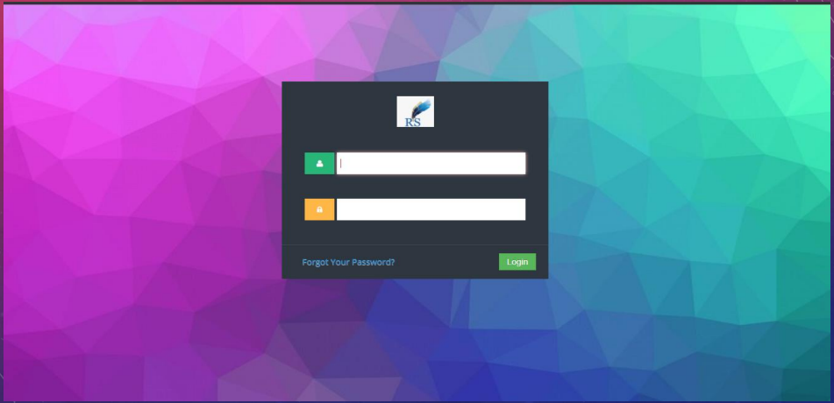
ADMIN END

Slide 30
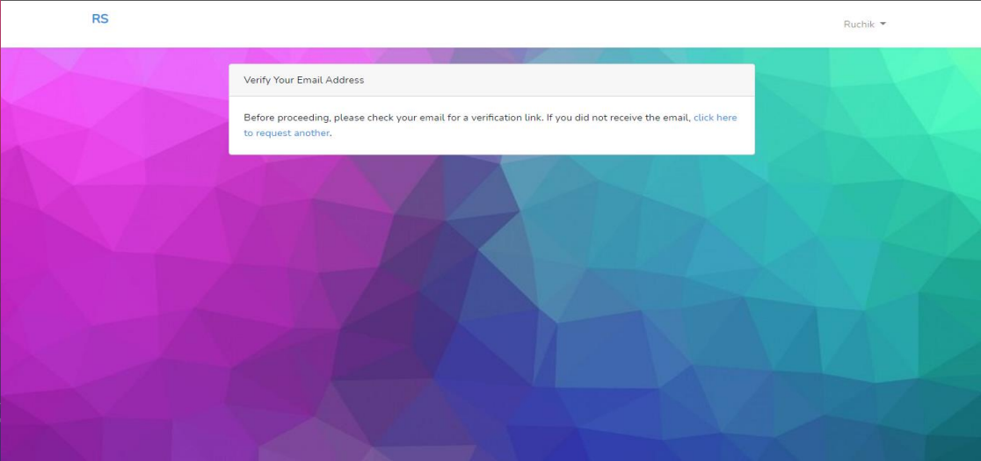
EMAIL VERIFICATION

Slide 31
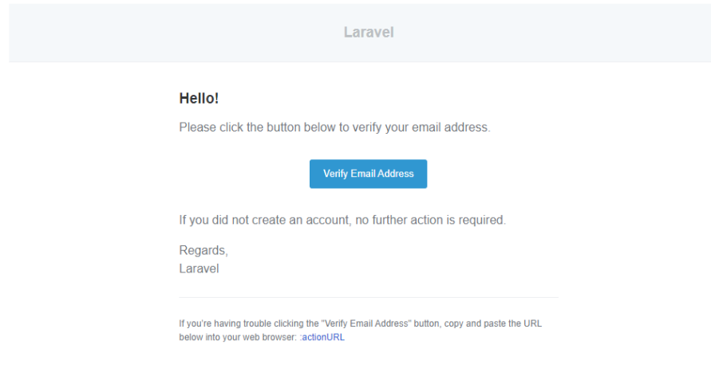
ADMIN END

Slide 32
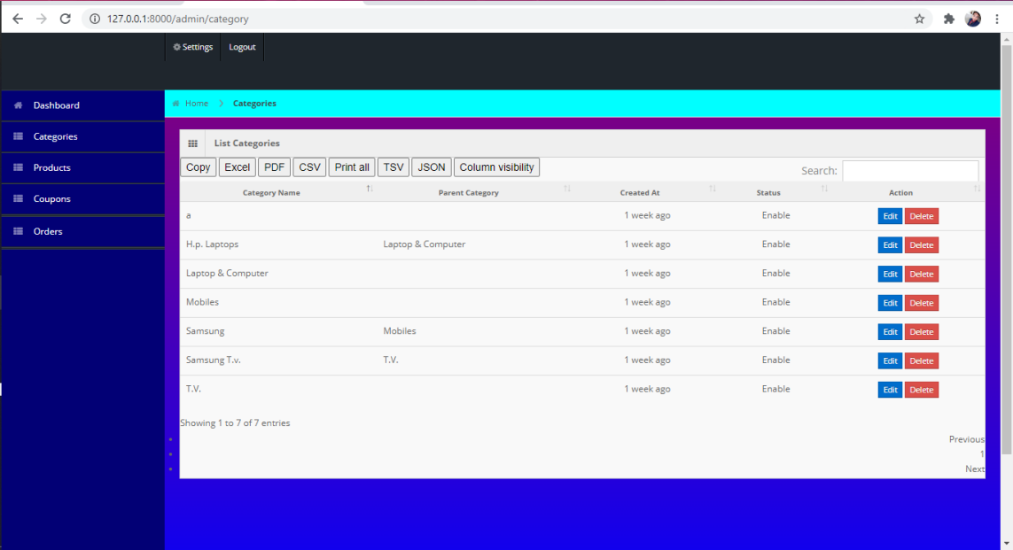
CATEGORY

Slide 33
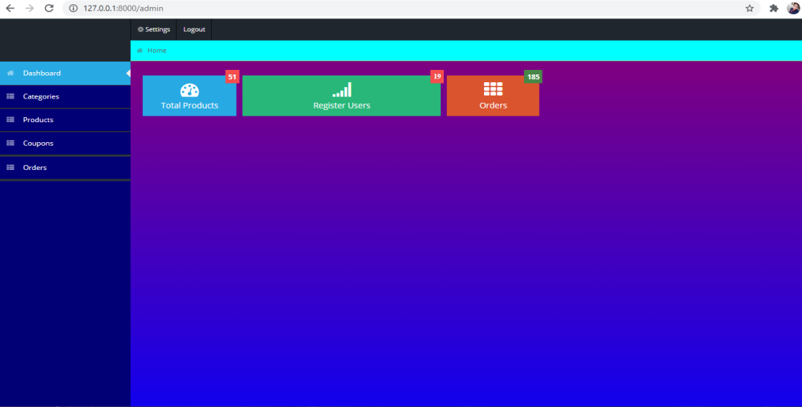
HOME PAGE

Slide 34
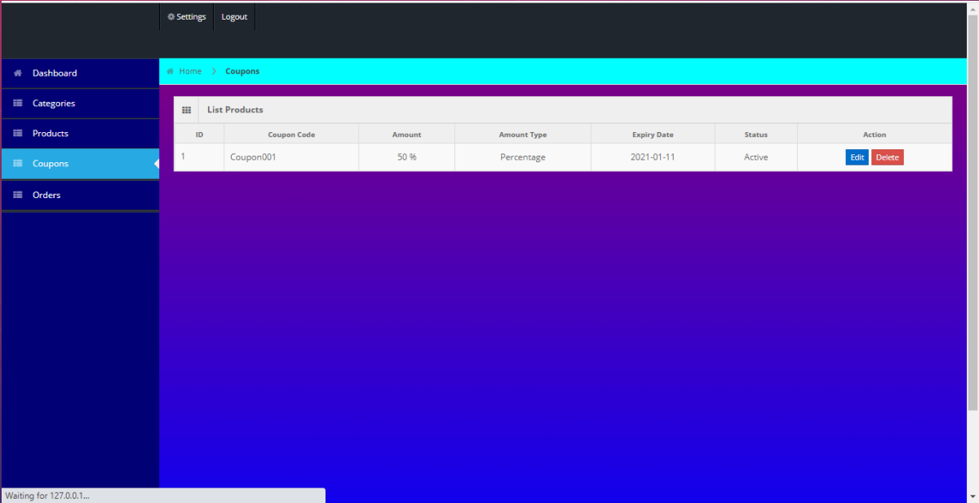
ADMIN SIDE

Slide 35
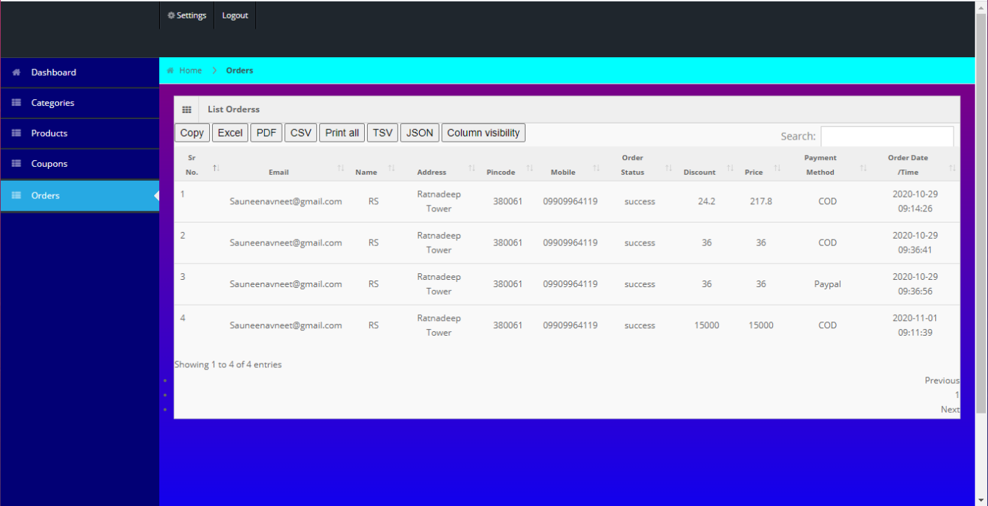
ORDERS

Slide 36
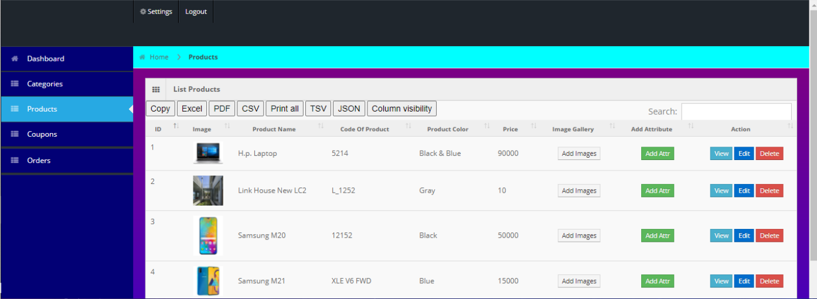
PRODUCT

Slide 37
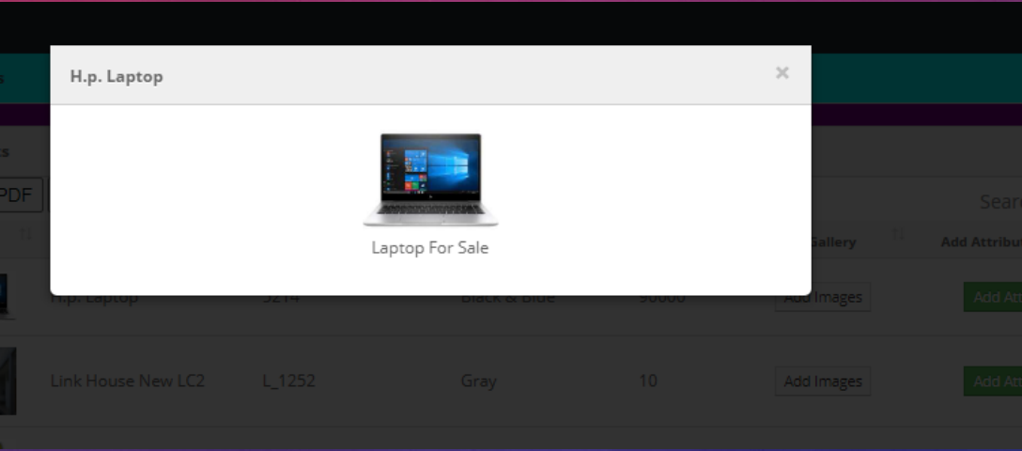
PRODUCT VIEW

Slide 38
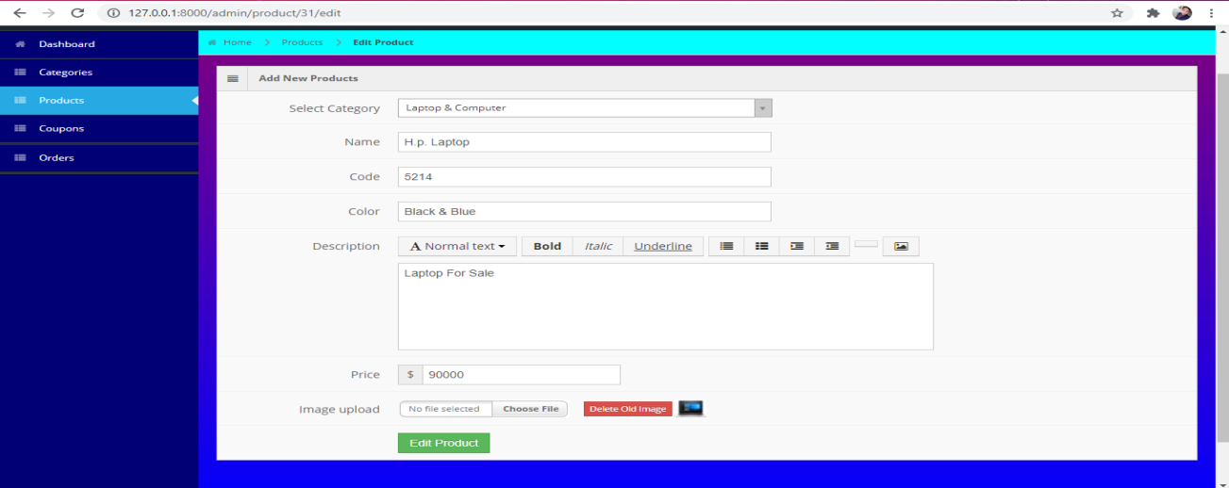
PRODUCT EDIT

Slide 39
PRODUCT EDIT

Slide 40
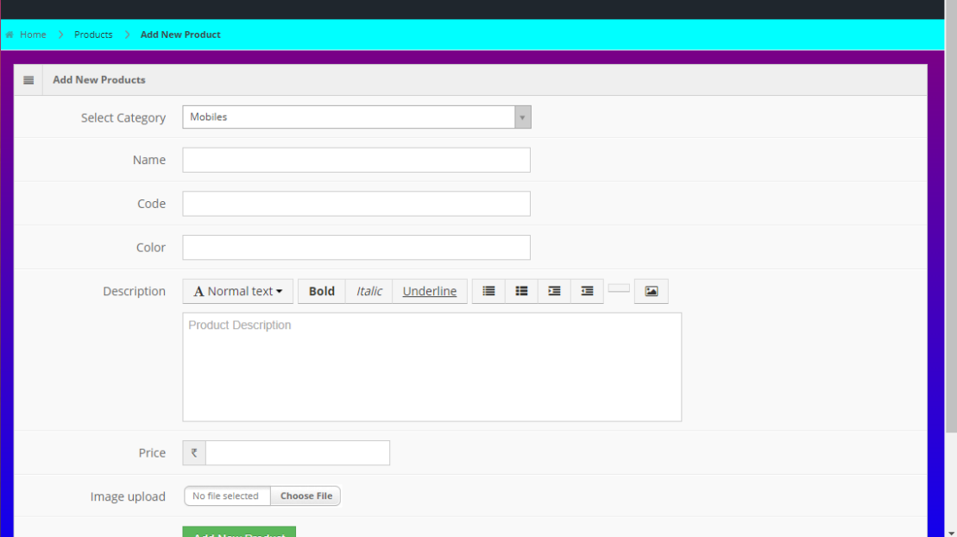
PRODUCT INSERT

Slide 41
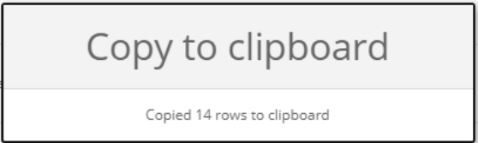
REPORTS COPY RECORD

Slide 42
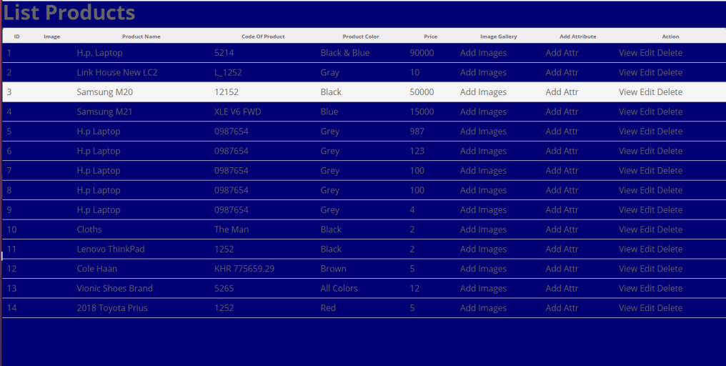
REPORTS PRINT RECORD

Slide 43
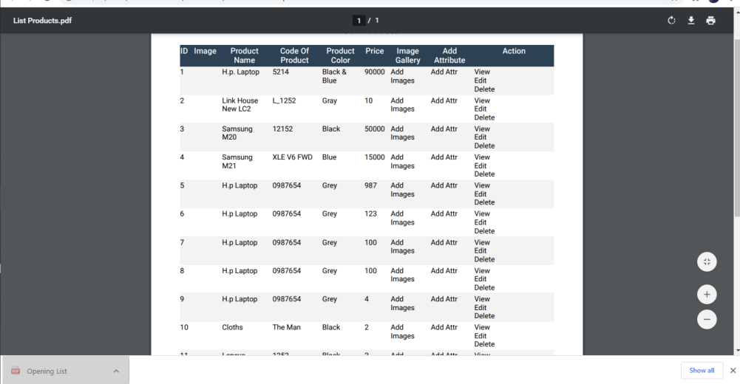
REPORTS PDF

Slide 44
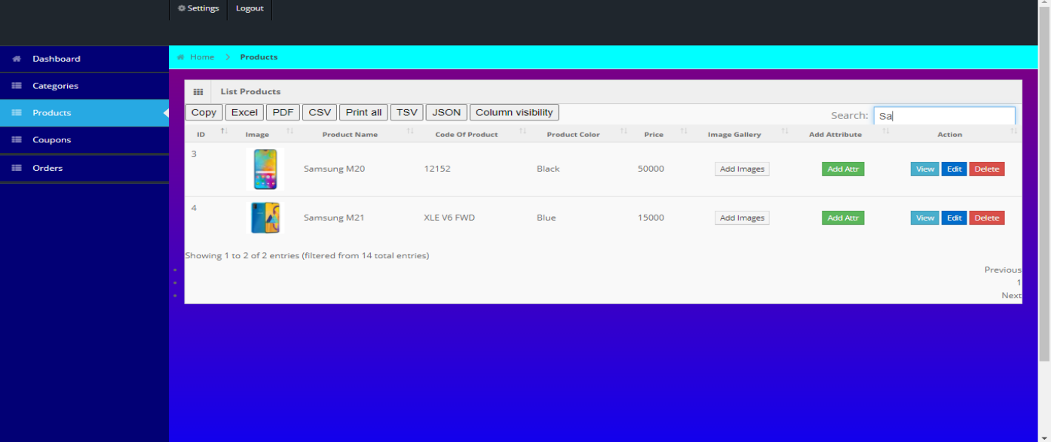
SEARCHING

Slide 45
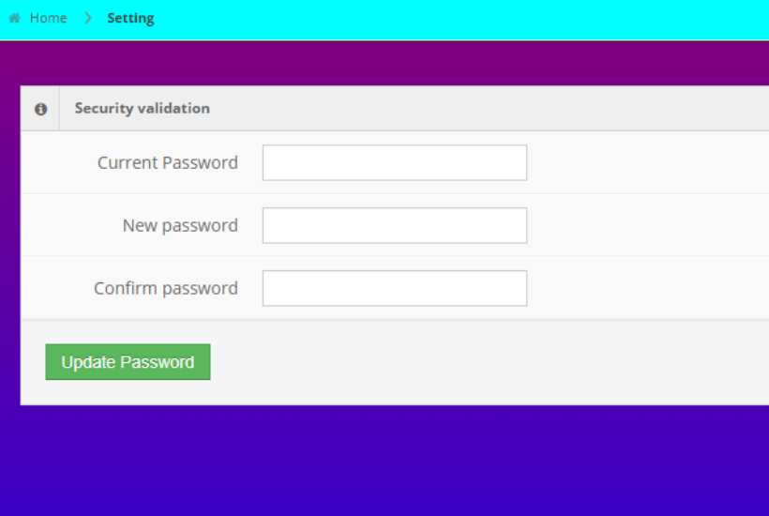
CHANGE PASSWORD

Slide 46
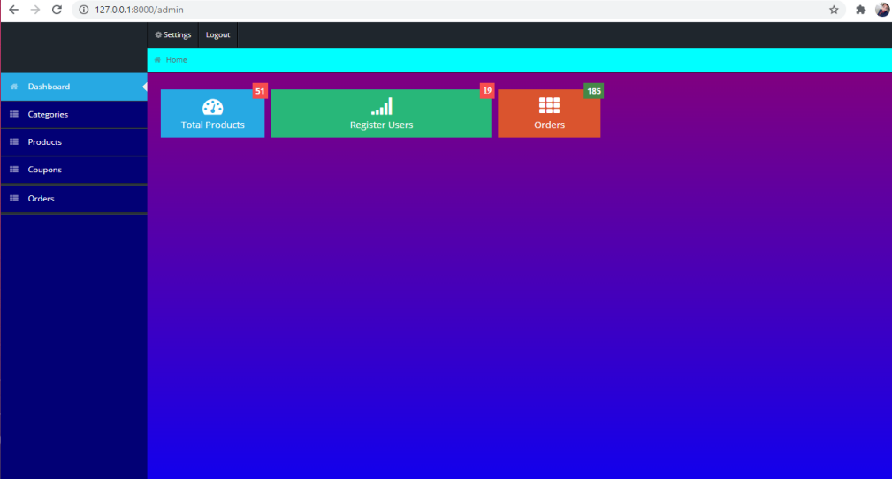
ADMIN LOGOUT

Slide 47
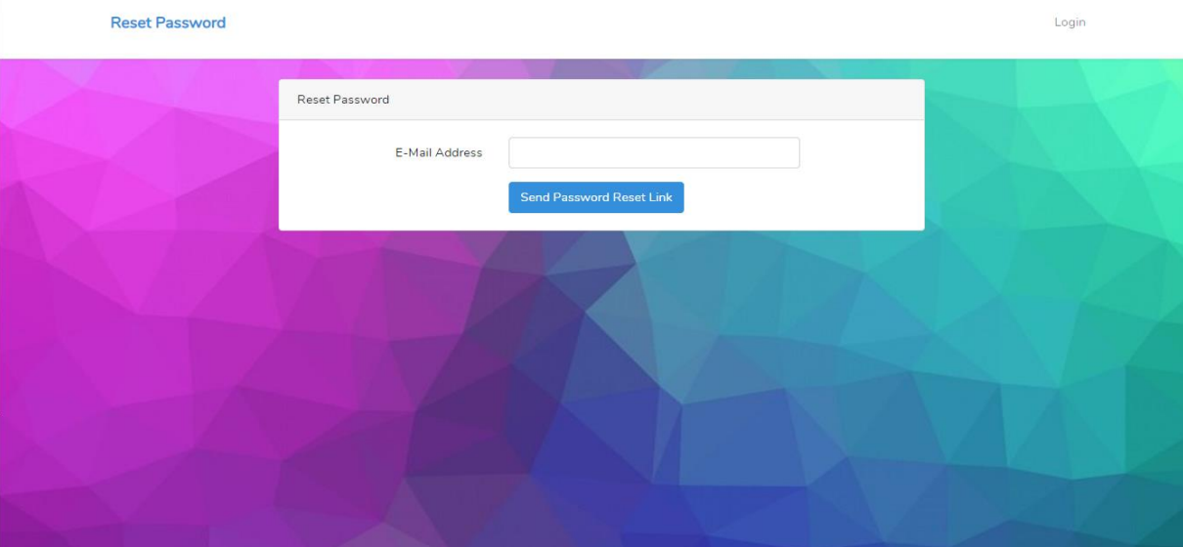
FORGOT PASSWORD

Slide 48
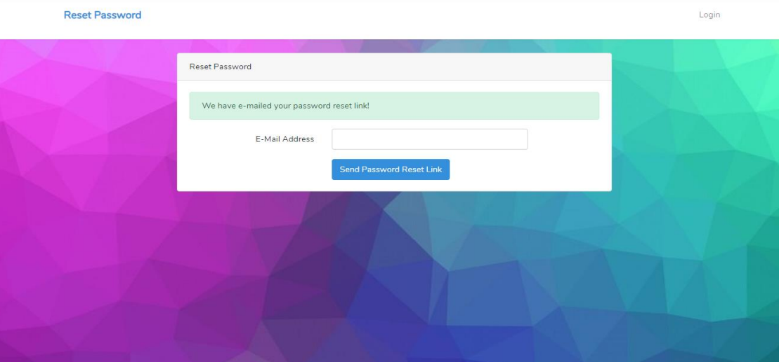
RESET PASSWORD

Slide 49
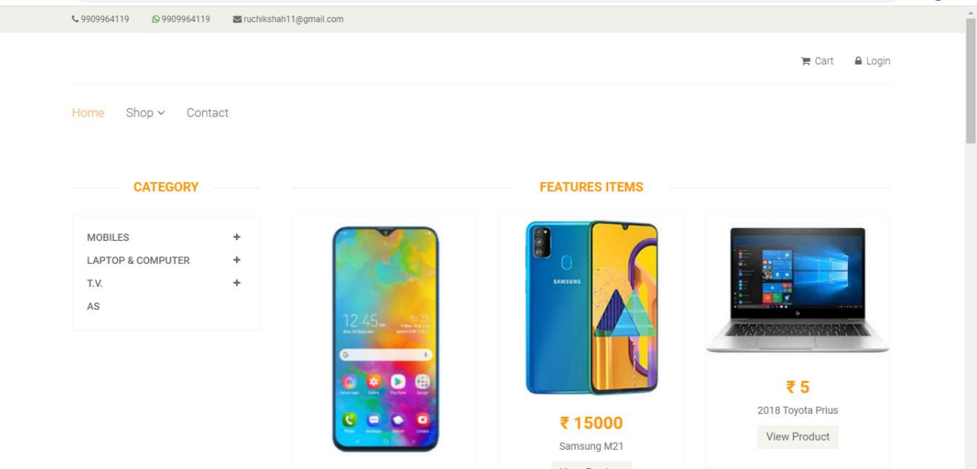
CLIENT SIDE

Slide 50
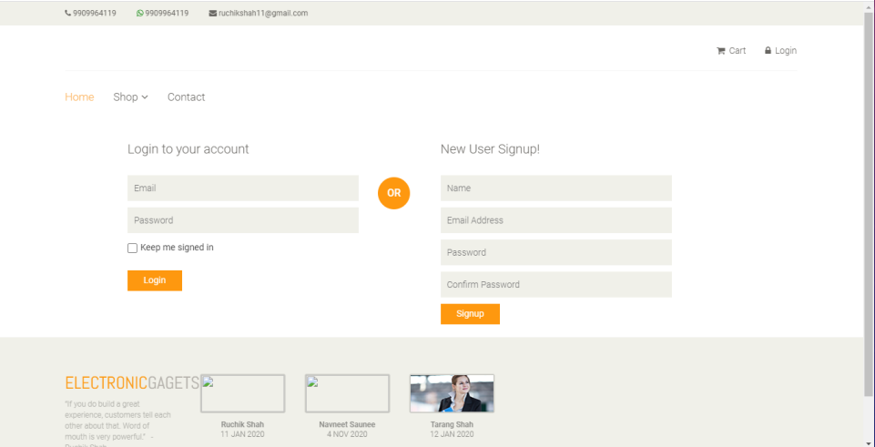
CLIENT SIDE LOGIN AND REGISTRATION

Slide 51
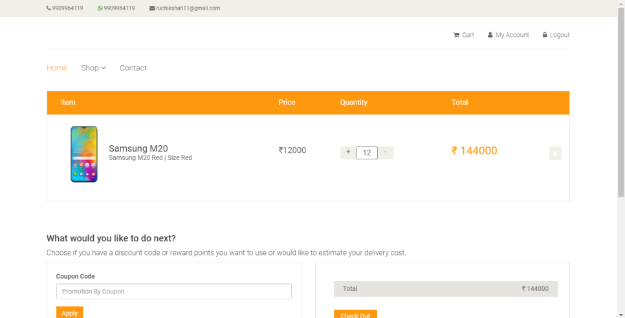
CLIENT SIDE CART

Slide 52
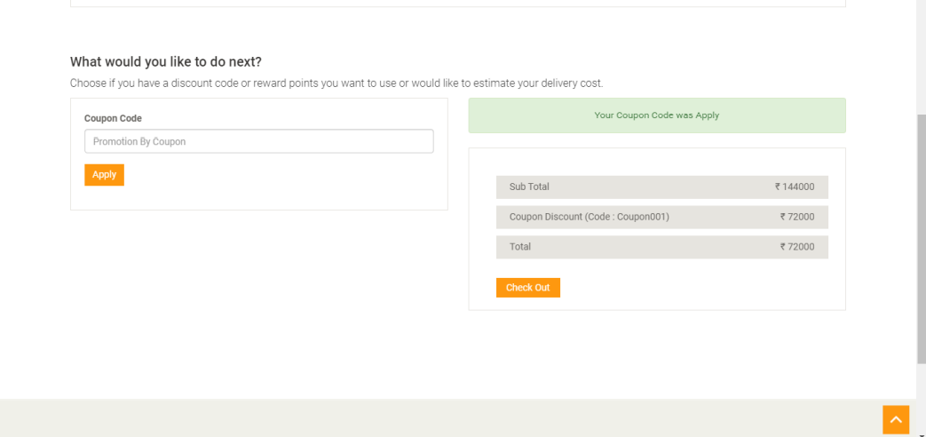
CLIENT COUPON

Slide 53
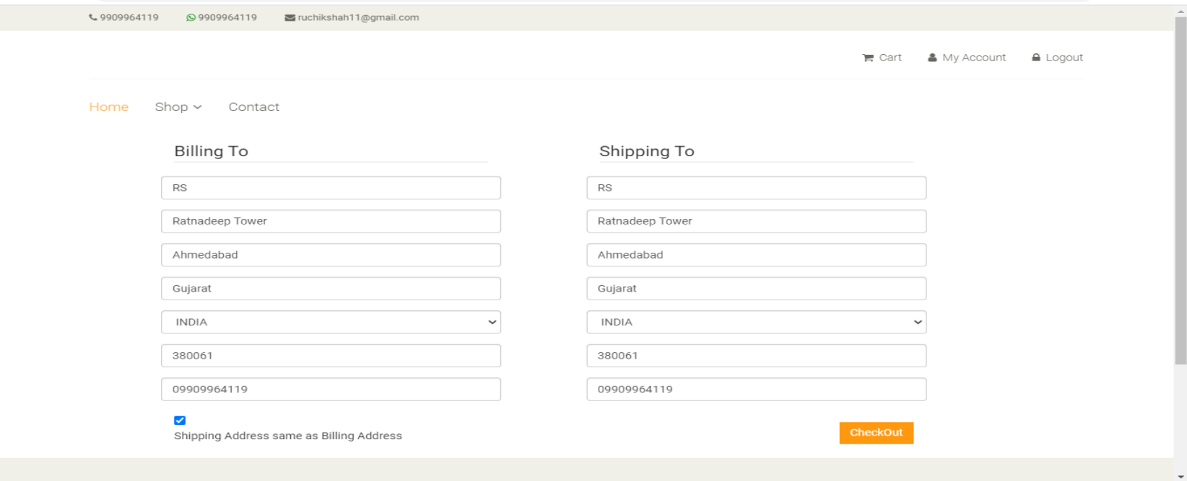
CLIENT CHECKOUT

Slide 54
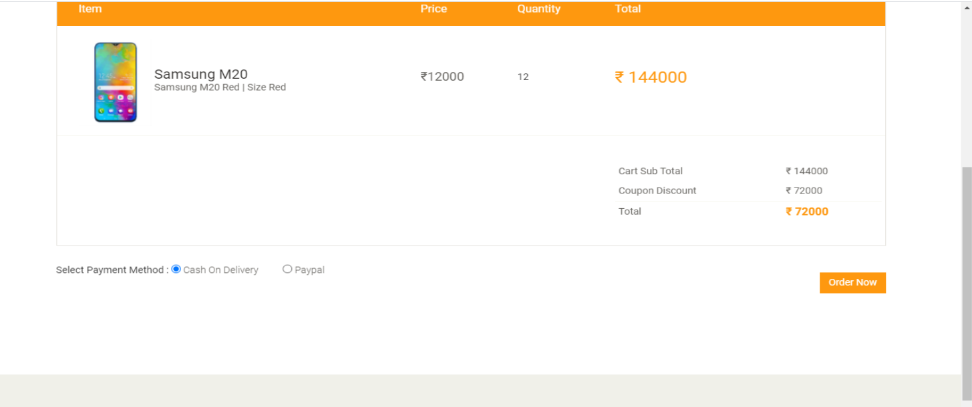
CLIENT ORDER REVIEW

Slide 55
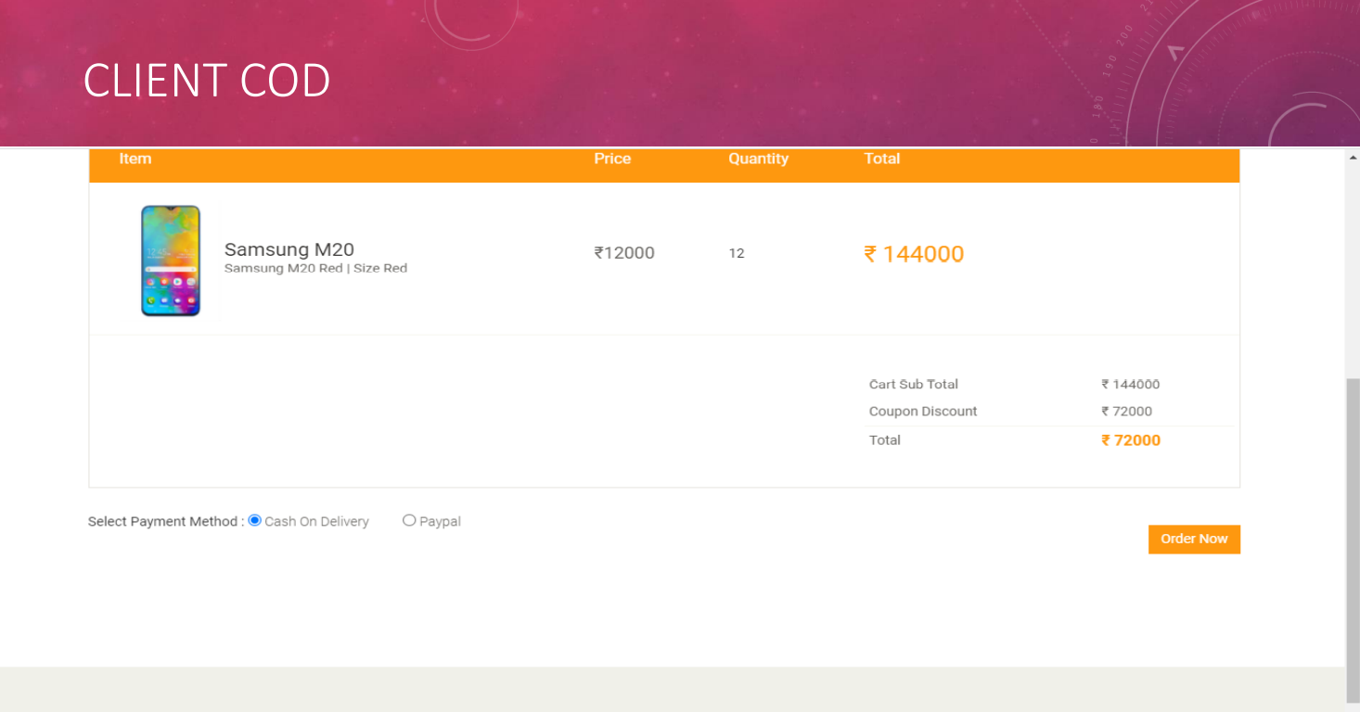
CLIENT COD

Slide 56
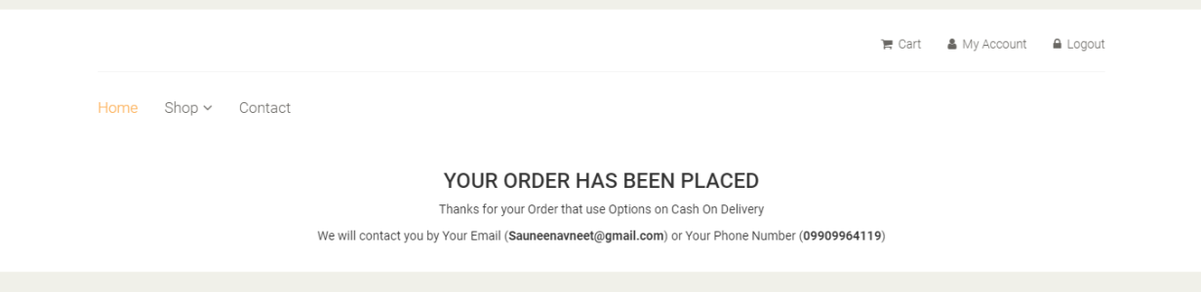
CLIENT COD

Slide 57
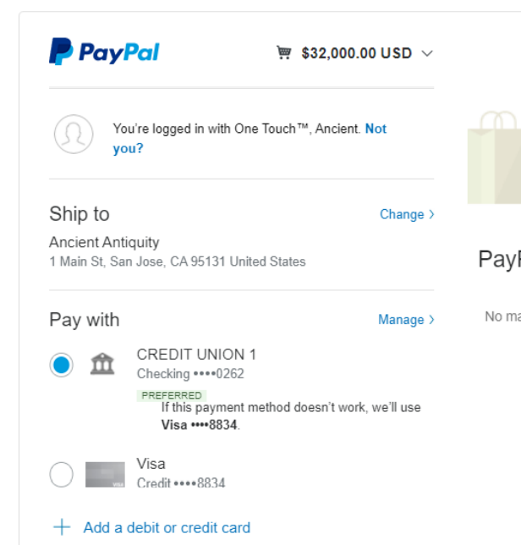
CLIENT PAYPAL

Slide 58
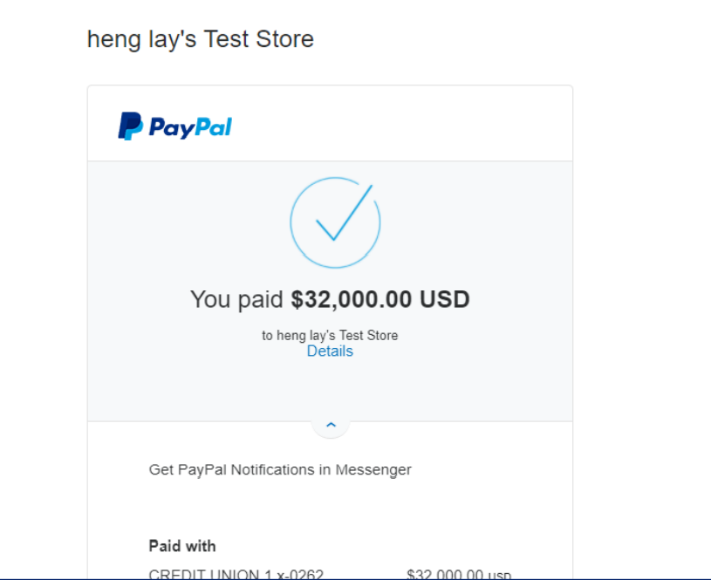
CLIENT SIDE PAYPAL

Slide 59
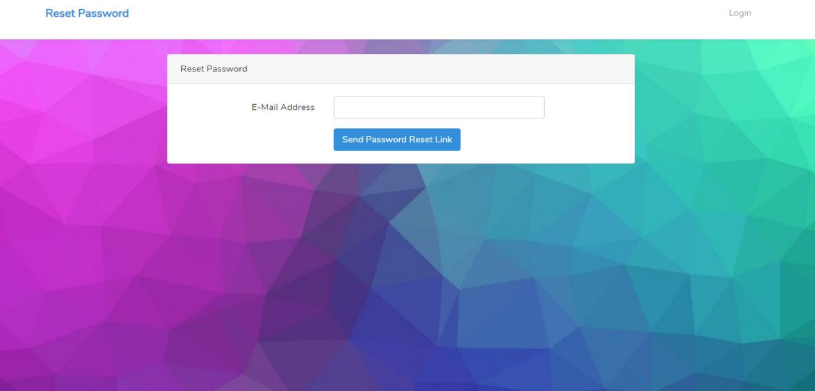
FORGOT PASSWORD

Slide 60
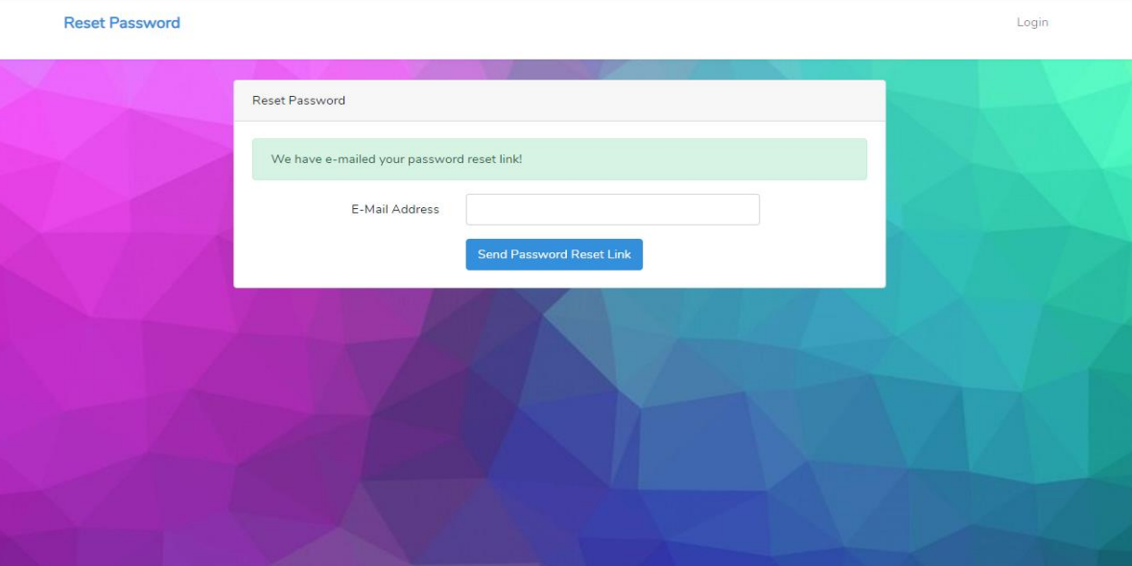
RESET PASSWORD

Slide 61
RESET PASSWORD

Slide 62
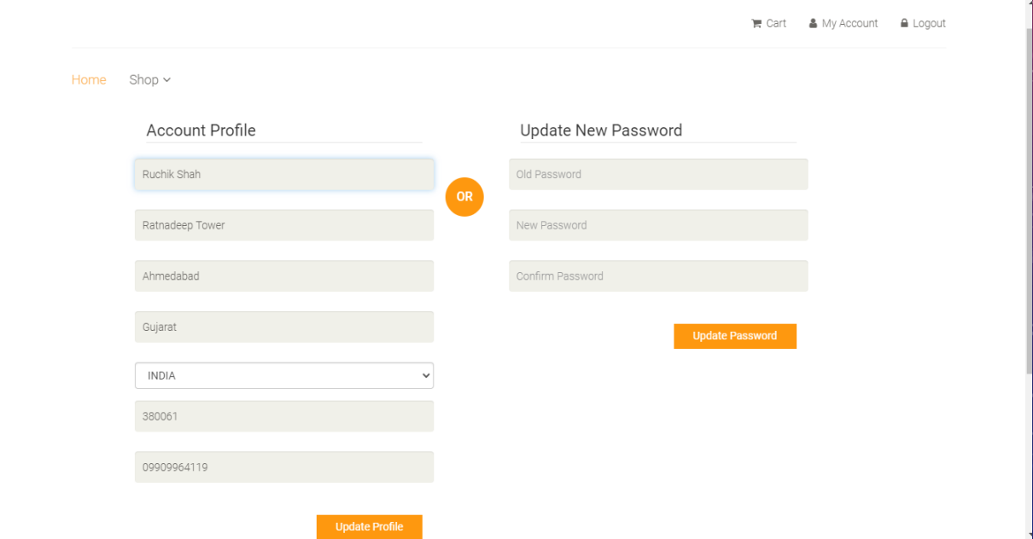
EDIT PROFILE

Slide 63


1.1 Existing System
Thank
You!
Thank You!
Thank
You!

